Slide 1

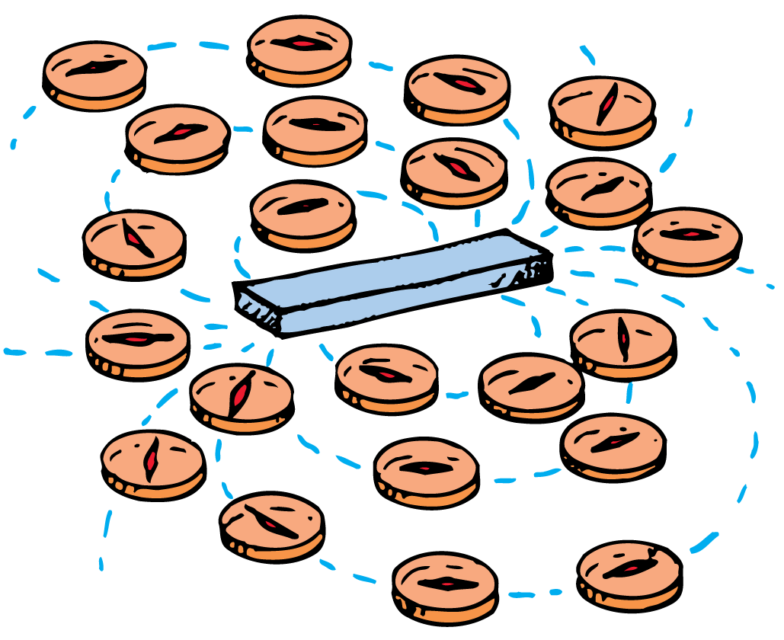

Magnetism Notes
A moving electric charge is surrounded by a magnetic field.

Slide 2
Magnetic Poles
Like poles repel; opposite poles attract.
Magnets exert forces on one another.
They are similar to electric charges, for they can both attract and repel without touching.
Like electric charges, the strength of their interaction depends on the distance of separation of the two magnets.
Electric charges produce electrical forces and regions called magnetic poles produce magnetic forces.

Slide 3
Magnetic Poles
If you suspend a bar magnet from its center by a piece of string, it will act as a compass.
The end that points northward is called the north-seeking pole.
The end that points southward is called the south-seeking pole.
More simply, these are called the north and south poles.
All magnets have both a north and a south pole. For a simple bar magnet the poles are located at the two ends.

Slide 4
Magnetic Poles
Magnetic poles behave similarly to electric charges in some ways, but there is a very important difference.
Electric charges can be isolated, but magnetic poles cannot.
A north magnetic pole never exists without the presence of a south pole, and vice versa.
The north and south poles of a magnet are like the head and tail of the same coin.

Slide 5
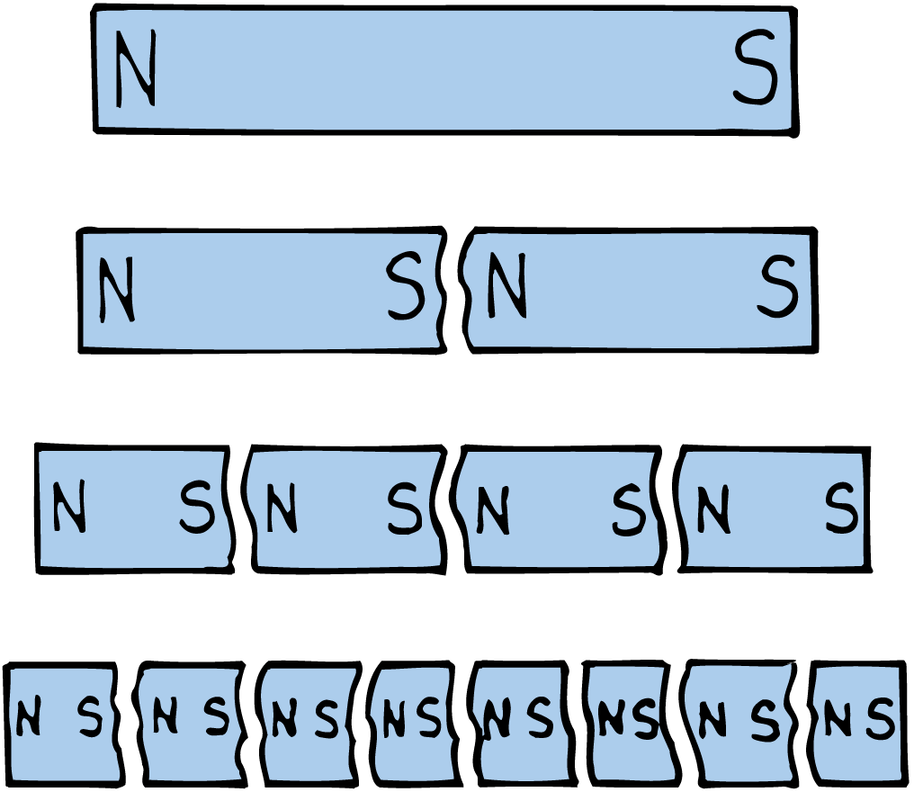
Magnetic Poles
If you break a bar magnet in half, each half still behaves as a complete magnet.
Break the pieces in half again, and you have four complete magnets.
Even when your piece is one atom thick, there are two poles. This suggests that atoms themselves are magnets.

Slide 6
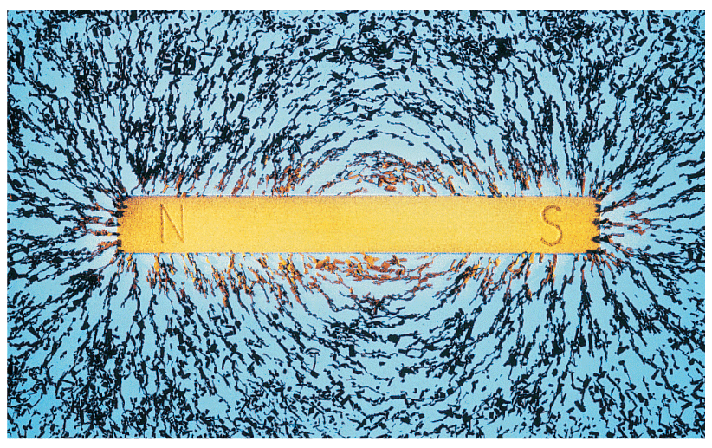
Magnetic Fields
The direction of the magnetic field outside a magnet is from the north to the south pole.
Iron filings sprinkled on a sheet of paper over a bar magnet will tend to trace out a pattern of lines that surround the magnet.
The space around a magnet, in which a magnetic force is exerted, is filled with a magnetic field.
The shape of the field is revealed by magnetic field lines.

Slide 7
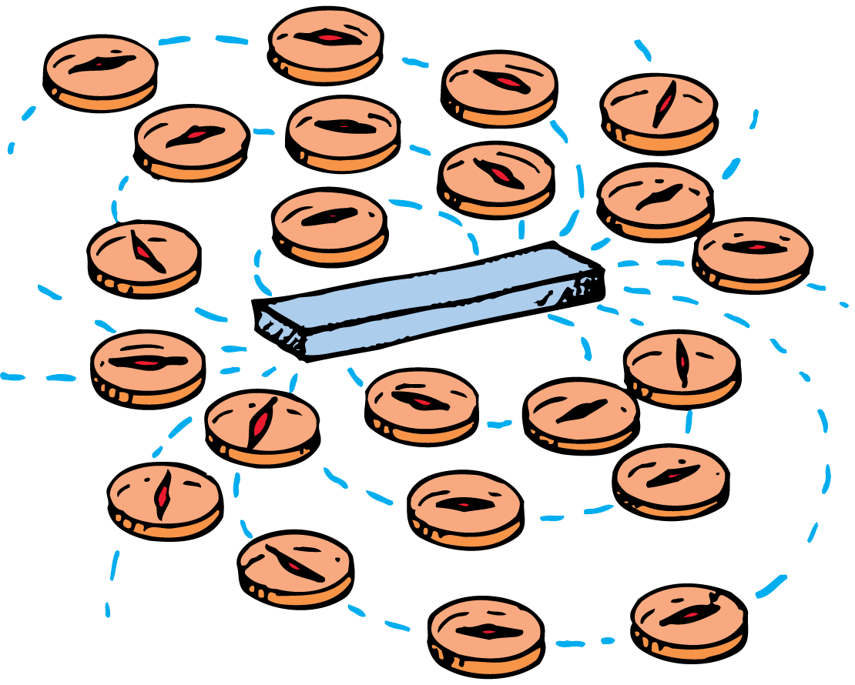
Magnetic Fields
The direction of the magnetic field outside a magnet is from the north to the south pole.
Where the lines are closer together, the field strength is greater.
The magnetic field strength is greater at the poles.
If we place another magnet or a small compass anywhere in the field, its poles will tend to line up with the magnetic field.

Slide 8
The Nature of a Magnetic Field
A magnetic field is produced by the motion of electric charge.
Magnetism is very much related to electricity.
Just as an electric charge is surrounded by an electric field, a moving electric charge is also surrounded by a magnetic field.
Charges in motion have associated with them both an electric and a magnetic field.

Slide 9
The Nature of a Magnetic Field
Electrons in Motion
Where is the motion of electric charges in a common bar magnet?
The magnet as a whole may be stationary, but it is composed of atoms whose electrons are in constant motion about atomic nuclei.
This moving charge constitutes a tiny current and produces a magnetic field.

Slide 10
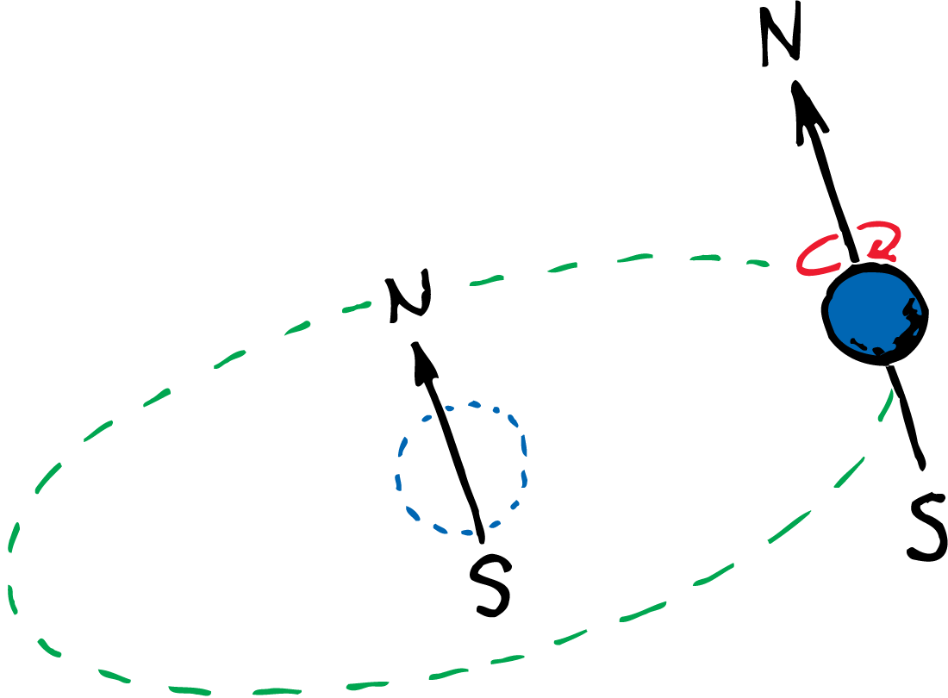
The Nature of a Magnetic Field
More important, electrons can be thought of as spinning about their own axes like tops.
A spinning electron creates another magnetic field.
In most materials, the field due to spinning predominates over the field due to orbital motion.

Slide 11
The Nature of a Magnetic Field
Spin Magnetism
Every spinning electron is a tiny magnet.
A pair of electrons spinning in the same direction makes up a stronger magnet.
Electrons spinning in opposite directions work against one another.
Their magnetic fields cancel.

Slide 12
The Nature of a Magnetic Field
Most substances are not magnets because the various fields cancel one another due to electrons spinning in opposite directions.
In materials such as iron, nickel, and cobalt, however, the fields do not cancel one another entirely.
An iron atom has four electrons whose spin magnetism is not canceled.
Each iron atom, then, is a tiny magnet. The same is true to a lesser degree for the atoms of nickel and cobalt.

Slide 13
Electric Currents and Magnetic Fields
An electric current produces a magnetic field.
A moving charge produces a magnetic field.
An electric current passing through a conductor produces a magnetic field because it has many charges in motion.

Slide 14
Electric Currents and Magnetic Fields
The magnetic field surrounding a current-carrying conductor can be shown by arranging magnetic compasses around the wire.
The compasses line up with the magnetic field produced by the current, a pattern of concentric circles about the wire.
When the current reverses direction, the compasses turn around, showing that the direction of the magnetic field changes also.

Slide 15
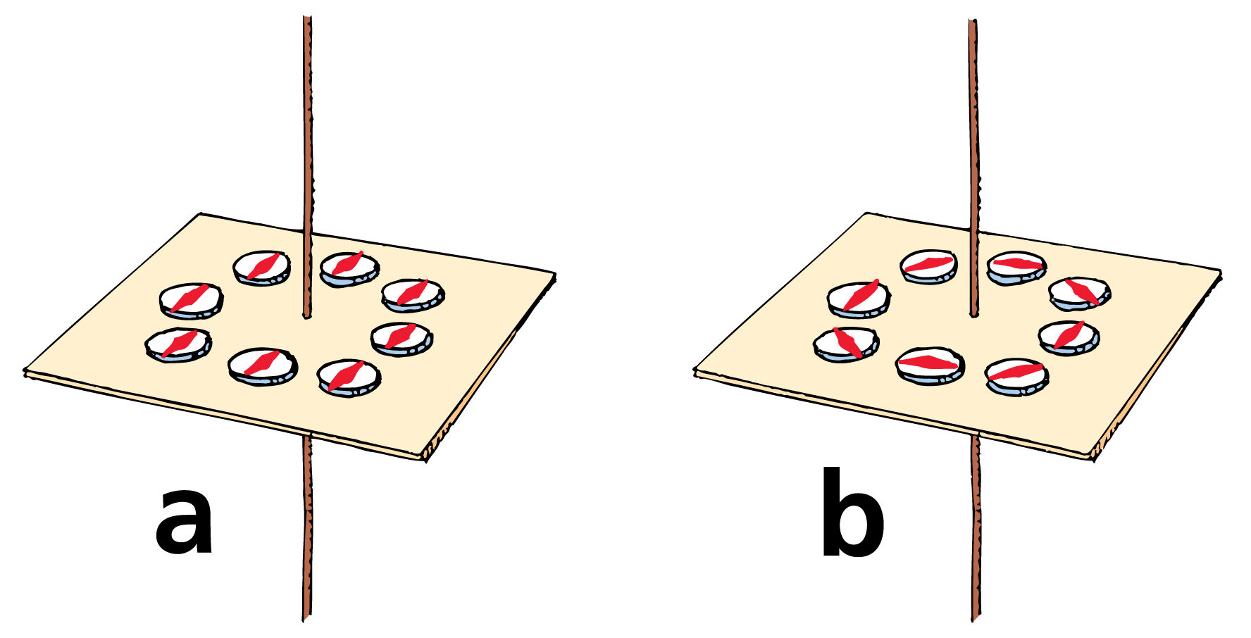
Electric Currents and Magnetic Fields
When there is no current in the wire, the compasses align with Earth’s magnetic field.
When there is a current in the wire, the compasses align with the stronger magnetic field near the wire.

Slide 16
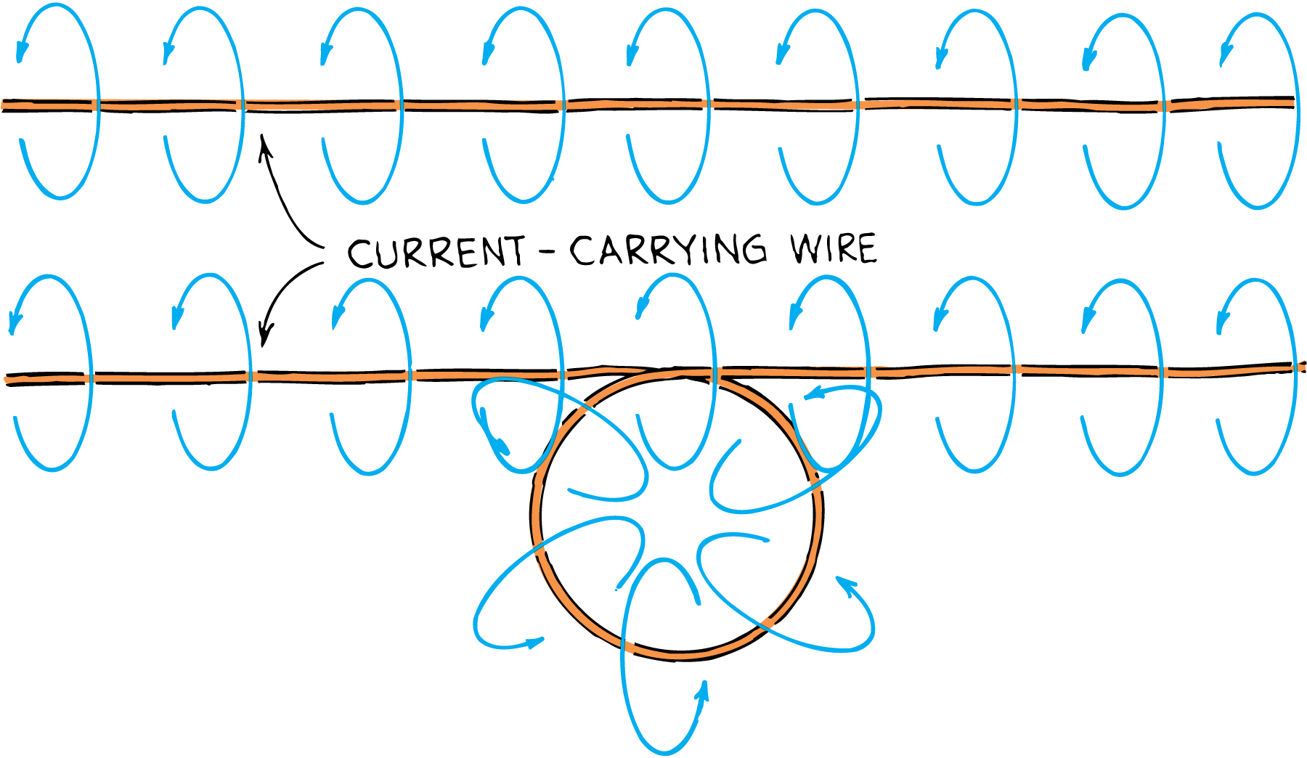
Electric Currents and Magnetic Fields
If the wire is bent into a loop, the magnetic field lines become bunched up inside the loop.
If the wire is bent into another loop, the concentration of magnetic field lines inside the double loop is twice that of the single loop.
The magnetic field intensity increases as the number of loops is increased.
A current-carrying coil of wire is an electromagnet.

Slide 17

Magnetic Forces on Moving Charged Particles
A moving charge is deflected when it crosses magnetic field lines but not when it travels parallel to the field lines.

Slide 18
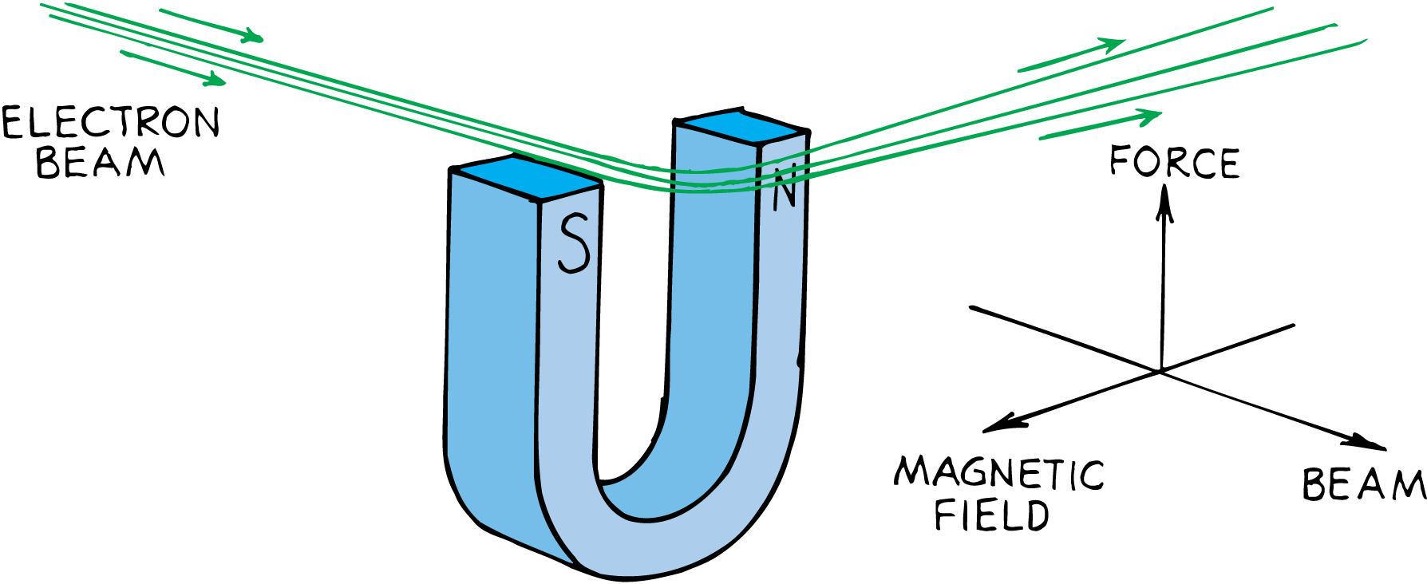
Magnetic Forces on Moving Charged Particles
If the charged particle moves in a magnetic field, the charged particle experiences a deflecting force.
This force is greatest when the particle moves in a direction perpendicular to the magnetic field lines.
At other angles, the force is less.
The force becomes zero when the particle moves parallel to the field lines.
The direction of the force is always perpendicular to both the magnetic field lines and the velocity of the charged particle.

Slide 19
Magnetic Forces on Moving Charged Particles
The deflecting force is different from other forces, such as the force of gravitation between masses, the electrostatic force between charges, and the force between magnetic poles.
The force that acts on a moving charged particle acts perpendicular to both the magnetic field and the electron velocity.

Slide 20
Magnetic Forces on Current-Carrying Wires
Since a charged particle moving through a magnetic field experiences a deflecting force, a current of charged particles moving through a magnetic field also experiences a deflecting force.

Slide 21
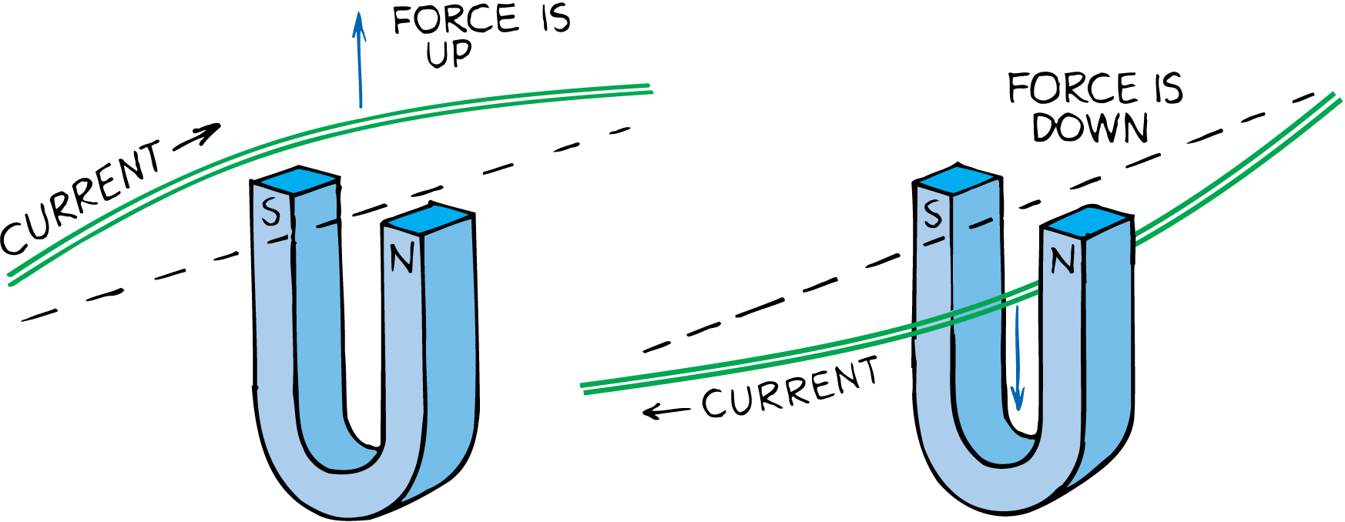
Magnetic Forces on Current-Carrying Wires
If the particles are inside a wire, the wire will also move.
If the direction of current in the wire is reversed, the deflecting force acts in the opposite direction.
The force is maximum when the current is perpendicular to the magnetic field lines.
The direction of force is along neither the magnetic field lines nor the direction of current.
The force is perpendicular to both field lines and current, and it is a sideways force.

Slide 22
Magnetic Forces on Current-Carrying Wires
Just as a current-carrying wire will deflect a magnetic compass, a magnet will deflect a current-carrying wire.
Both cases show different effects of the same phenomenon.
The discovery that a magnet exerts a force on a current-carrying wire created much excitement.
People began harnessing this force for useful purposes—electric meters and electric motors.

Slide 23
Earth’s Magnetic Field
A compass points northward because Earth itself is a huge magnet.

Slide 24
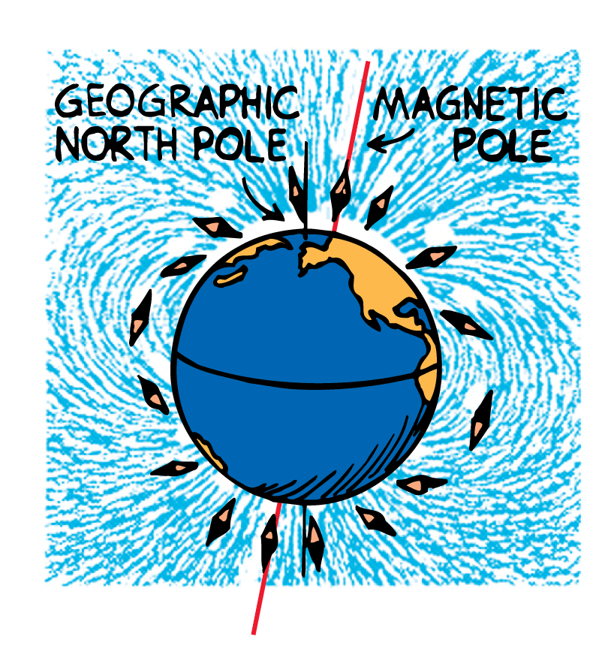
Earth’s Magnetic Field
The compass aligns with the magnetic field of Earth, but the magnetic poles of Earth do not coincide with the geographic poles.
The magnetic pole in the Northern Hemisphere, for example, is located some 800 kilometers from the geographic North Pole.
This means that compasses do not generally point to true north.
The discrepancy is known as the magnetic declination.

Slide 25
Earth’s Magnetic Field
Moving Changes Within Earth
The configuration of Earth’s magnetic field is like that of a strong bar magnet placed near the center of Earth.
Earth is not a magnetized chunk of iron like a bar magnet. It is simply too hot for individual atoms to remain aligned.

Slide 26
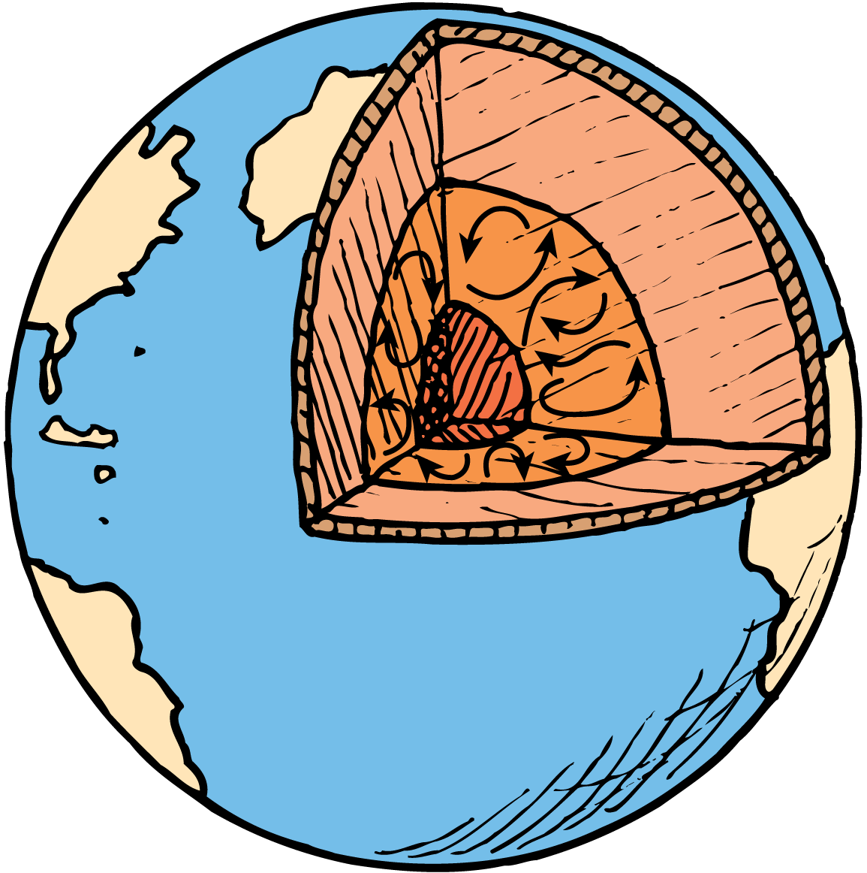
Earth’s Magnetic Field
Currents in the molten part of Earth beneath the crust provide a better explanation for Earth’s magnetic field.
Most geologists think that moving charges looping around within Earth create its magnetic field. Because of Earth’s great size, the speed of charges would have to be less than one millimeter per second to account for the field.
Another possible cause for Earth’s magnetic field is convection currents from the rising heat of Earth’s core. Perhaps such convection currents combined with the rotational effects of Earth produce Earth’s magnetic field.

Slide 27
Earth’s Magnetic Field
Magnetic Field Reversals
The magnetic field of Earth is not stable. Magnetic rock strata show that it has flip-flopped throughout geologic time.
Iron atoms in a molten state align with Earth’s magnetic field.
When the iron solidifies, the direction of Earth’s field is recorded by the orientation of the domains in the rock.

Slide 28
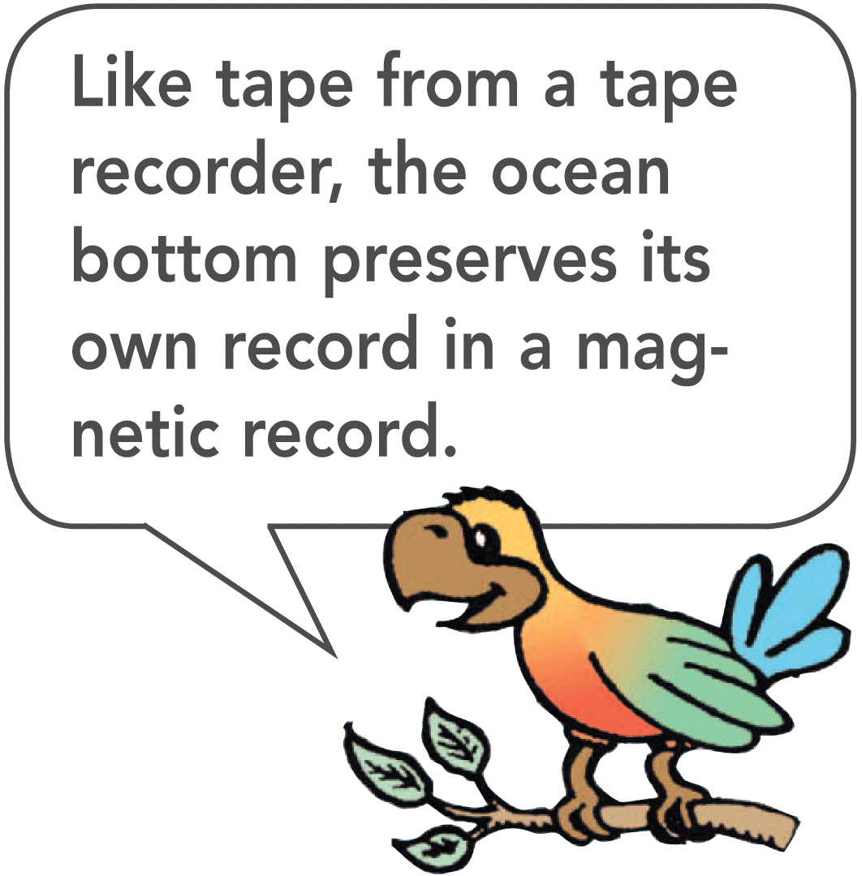
Earth’s Magnetic Field
On the ocean floor at mid-ocean ridges, continuous eruption of lava produces new seafloor.
This new rock is magnetized by the existing magnetic field.
Alternating magnetic stripes show that there have been times when the Earth’s magnetic field has dropped to zero and then reversed.

